Slide 1
Schrodinger Cat
Rakhee Bhojakar, Chelsea Brooks, Erik Fox, Dhakshayini Koppad, Jamie Williams

Slide 2
Schrodinger Cat
Project Summary
Project Contribution
Before/After Photos
Text to Speech
Facial/Object Recognition
Face/3D Printing
Servos

Slide 3
Project Summary
Schrodinger Cat (what used to be the Einstein robot) is one of the oldest robots in the lab. Schrodinger Cat is made up of a full body (head, arms, and legs controlled by servos) suspended above the ground by a base (which moves via a set of omni-wheels). The servos and motors are controlled with an Arduino Uno microcontroller. We added a Raspberry Pi to the head of the robot to add vision, speech, and a screen to the robot.

Slide 4
Project Contribution
Text to Speech/Speech to Text/Script – Chelsea
Face and Object Detection - Rakhee
Servos, Script writing - Jamie
Omni-wheel Control and Hardware - Dhakshayini
ROS interfacing, 3D Printing/Screen Face - Erik

Slide 5
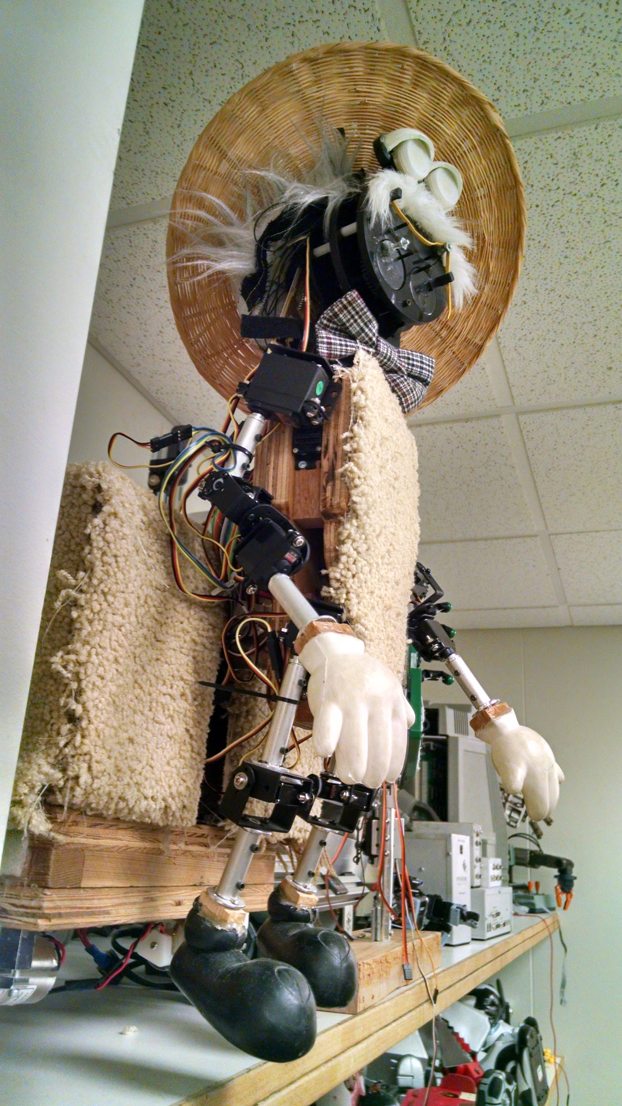
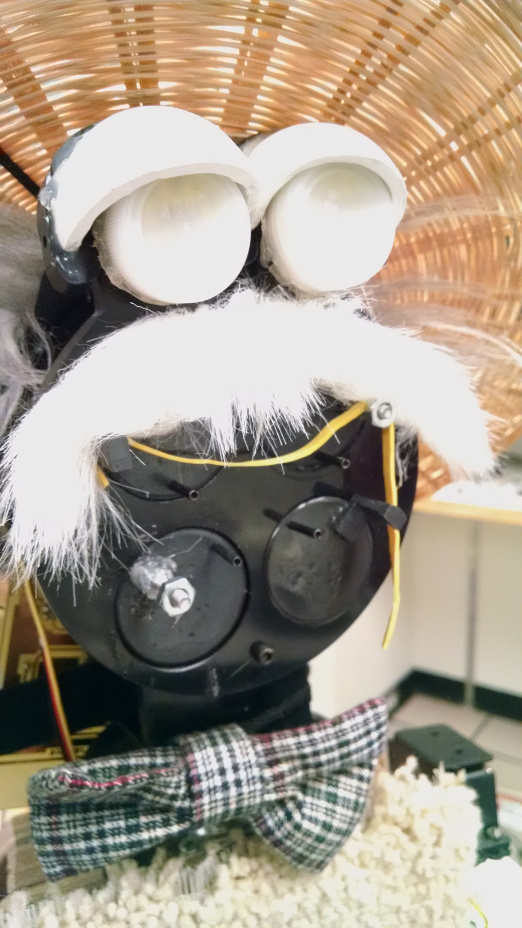
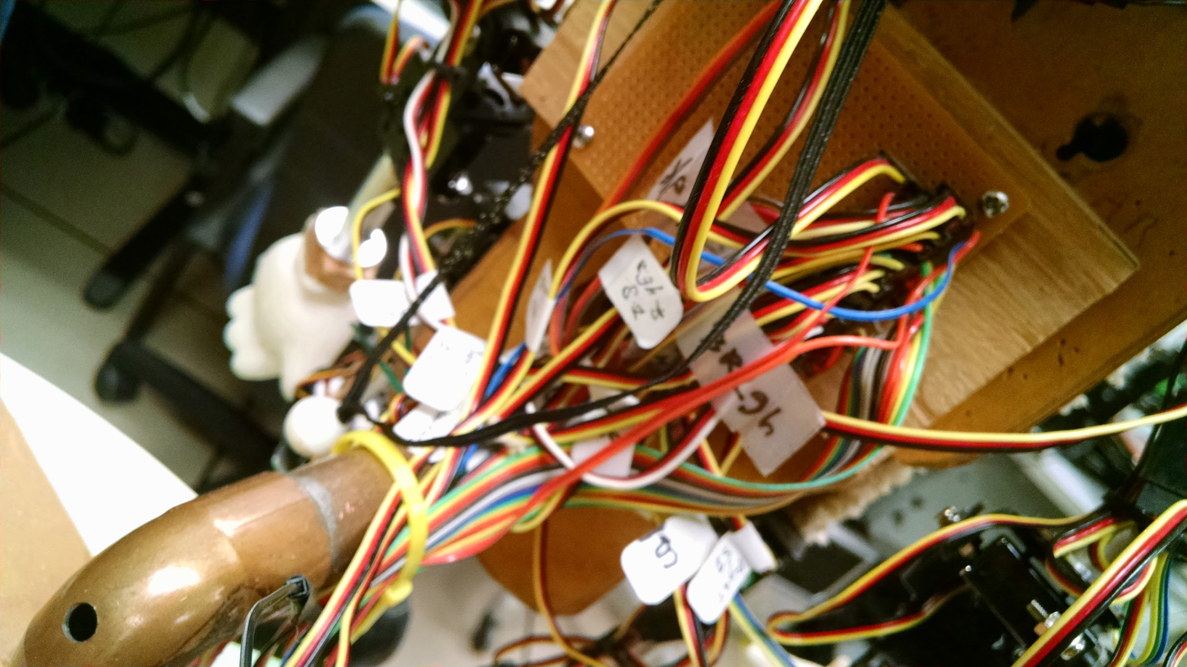
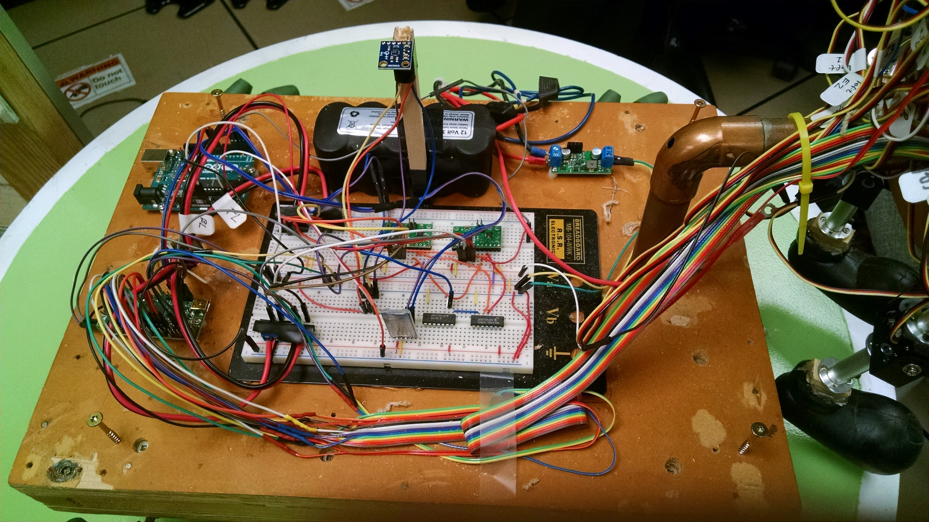
Before Pictures

Slide 6
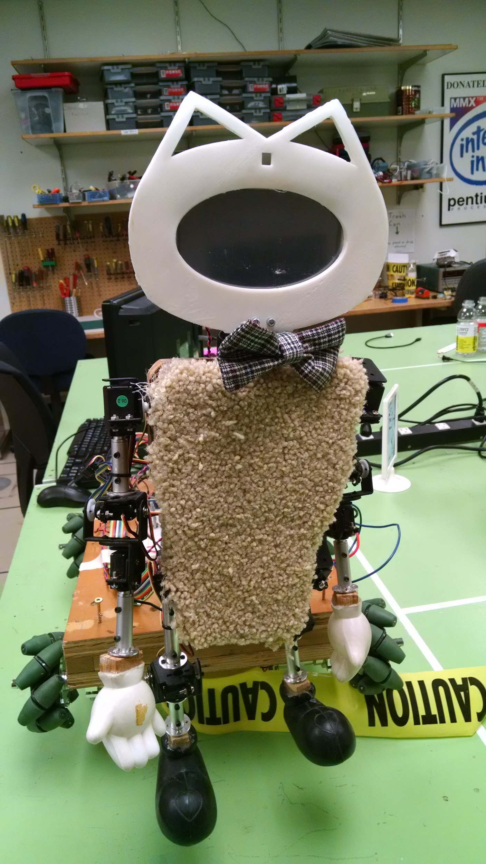
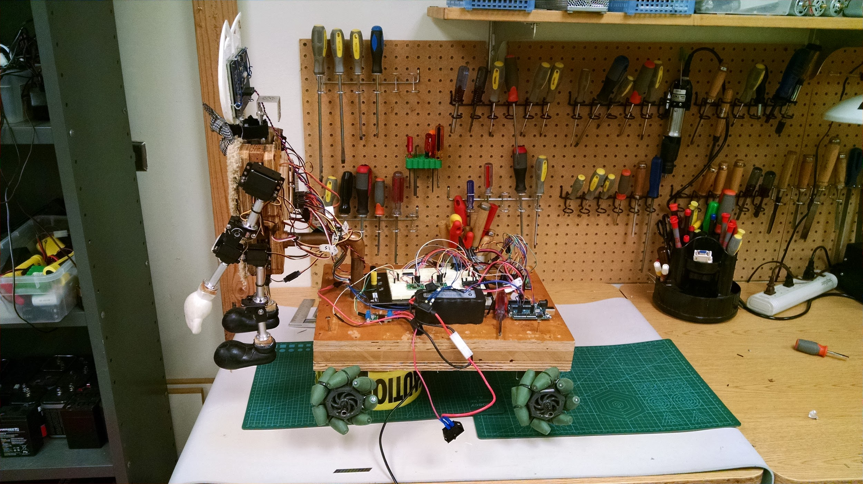
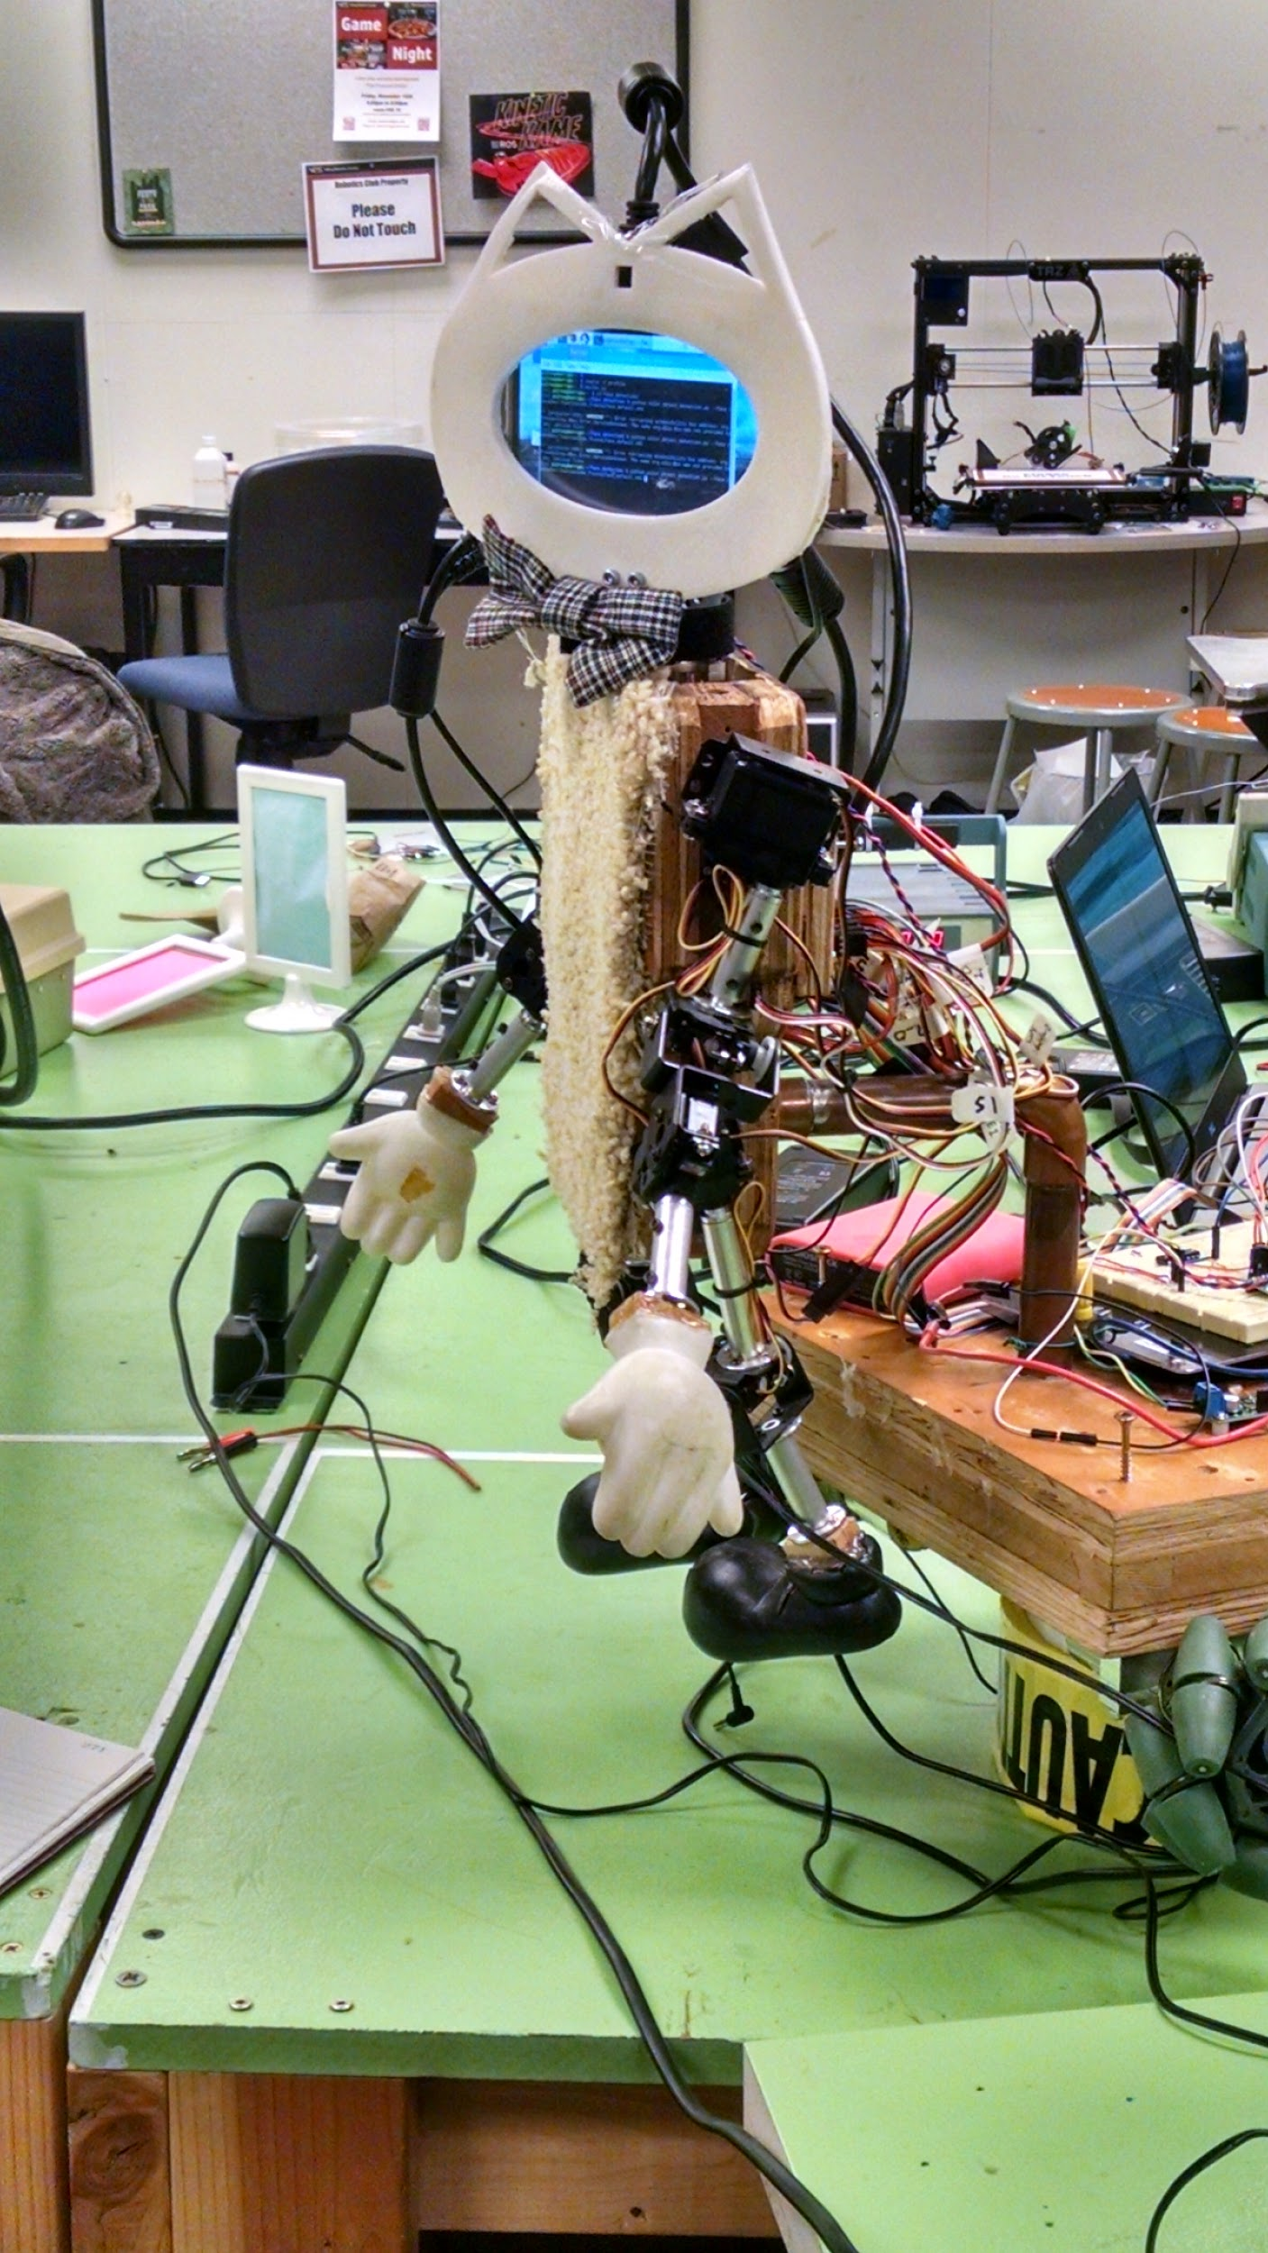
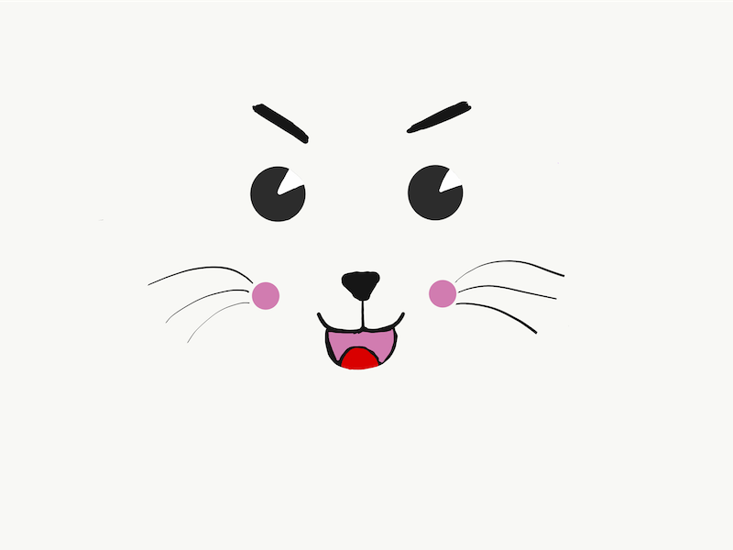
After Pictures

Slide 7
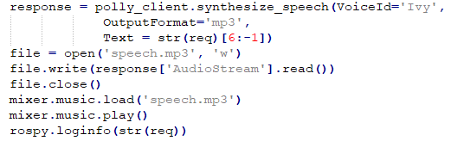
Text to Speech - Amazon Polly
The robot did not have any text to speech capability
Amazon Polly

Slide 8
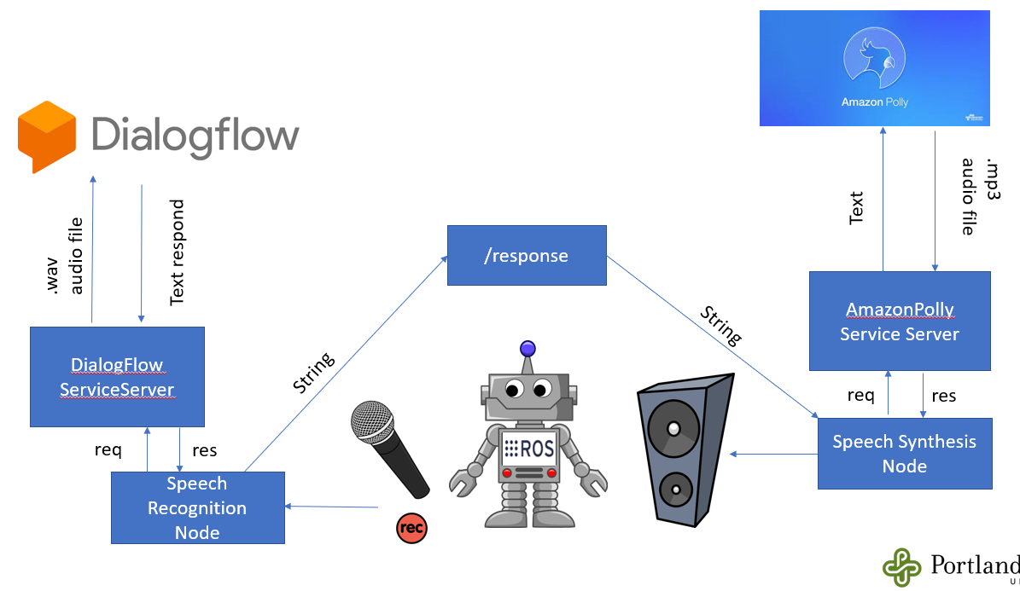
Speech to Text - Dialogflow
Train robot to respond to different questions
Pass responses to Amazon polly through ROS

Slide 9
Face and Object Detection - Past Work / Our Design
Robot detection - HSV green Color detection
Both algorithms work on images captured from camera connected to raspberry pi
Used OpenCv, python, ROS node
Once it detects object it speaks using amazon polly

Slide 10
Face and Object Detection - Challenges / Future Work
As computation on raspberry pi increases, frames per second reduces resulting in delayed reaction
Tracking of mouse needs to be done
It only detects person but not recognize
It does not take any action when it sees person and mouse it just speaks
Communication between arduino and raspberry pi to control robot needs to be done

Slide 11
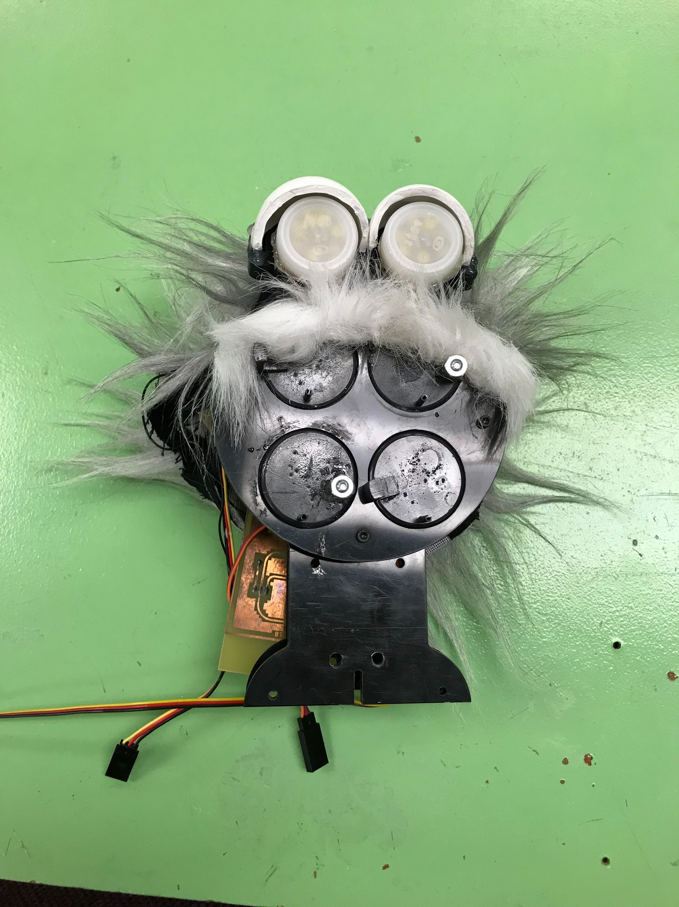
Face/3D Printing: Past work
Old Face was an ESRA: Expressive System for Robotic Expression.
Did not resemble a Cat, and animation capabilities were limited
Difficult to change or update for future iterations of the Schrodinger’s Cat Robot

Slide 12
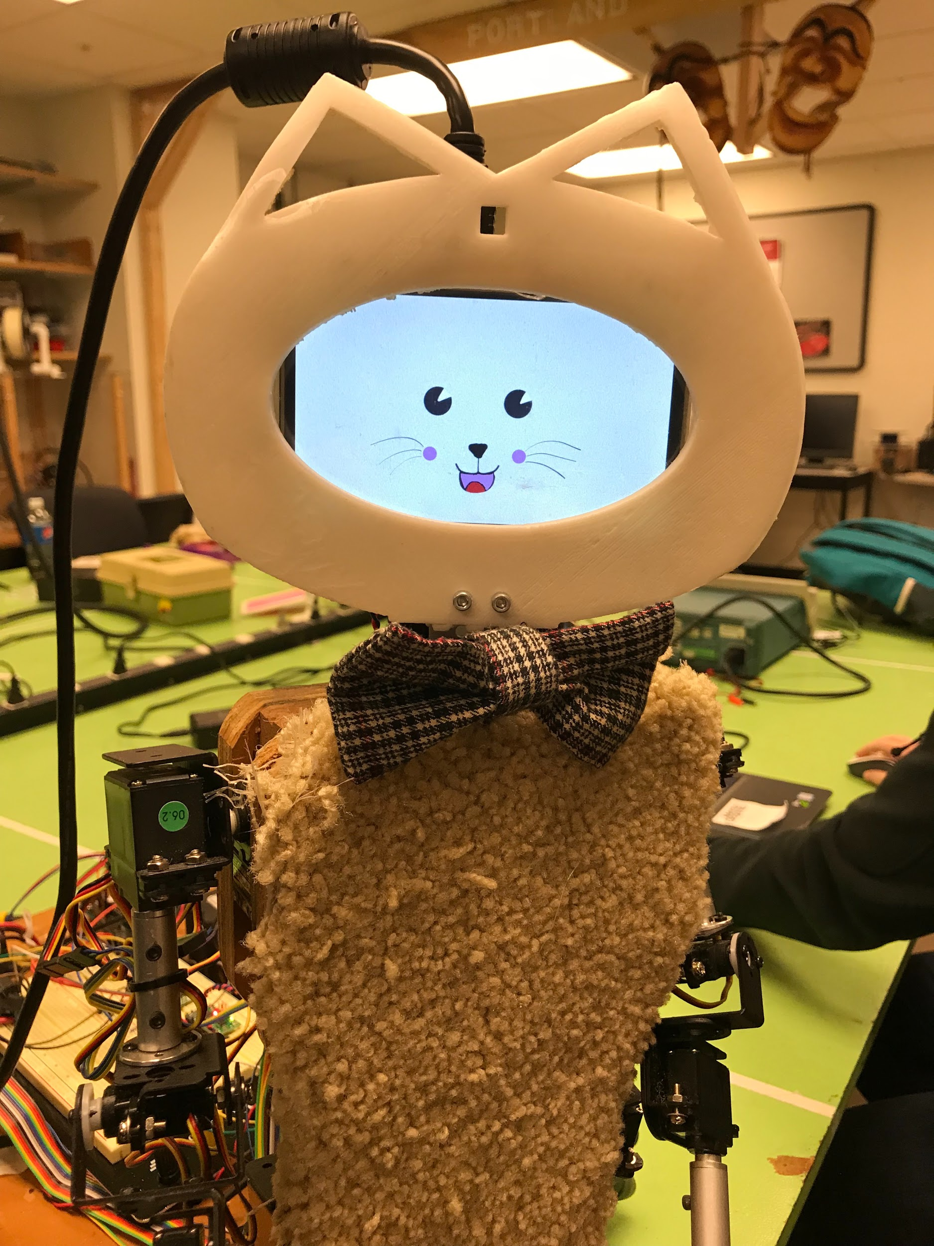
Face/3D Printing: Our design
Our head utilizes a LCD display framed by a 3D printed face.
3D printing and using digital animation allows the design to be more flexible.

Slide 13
Face/3D Printing: Challenges
Face node freezes ROS
3D Printing
Failed prints. Our design was large for the 3D printer in the Robotics lab. Uneven heat on the print surface allowed portions of the cat face to curve up.
Print resolution. My design allowed for +/- 2mm. This was too narrow.
LCD display and Animation:
Raspberry pi would not fill display.
OpenCV image display commands would not take ownership of display.

Slide 14
Adding ROS to the project
Goals:
ROS Networking
Integrate all robot capabilities using ROS
Results:
Scrapped ROS networking plan
Simplified vision integration
Separated vision and speech nodes, from servo control nodes

Slide 15
ROS: Challenges/Issues
Could not get networking between Raspberry Pi and Laptop nodes, or between laptop nodes
Lead to last minute re-design of node architecture
Have 3 separate ROS systems running
Speech output, Dialog Flow, camera
Robot movement (currently not working with ROS)
Director node, wheels, servos
Other team’s robot node structure

Slide 16
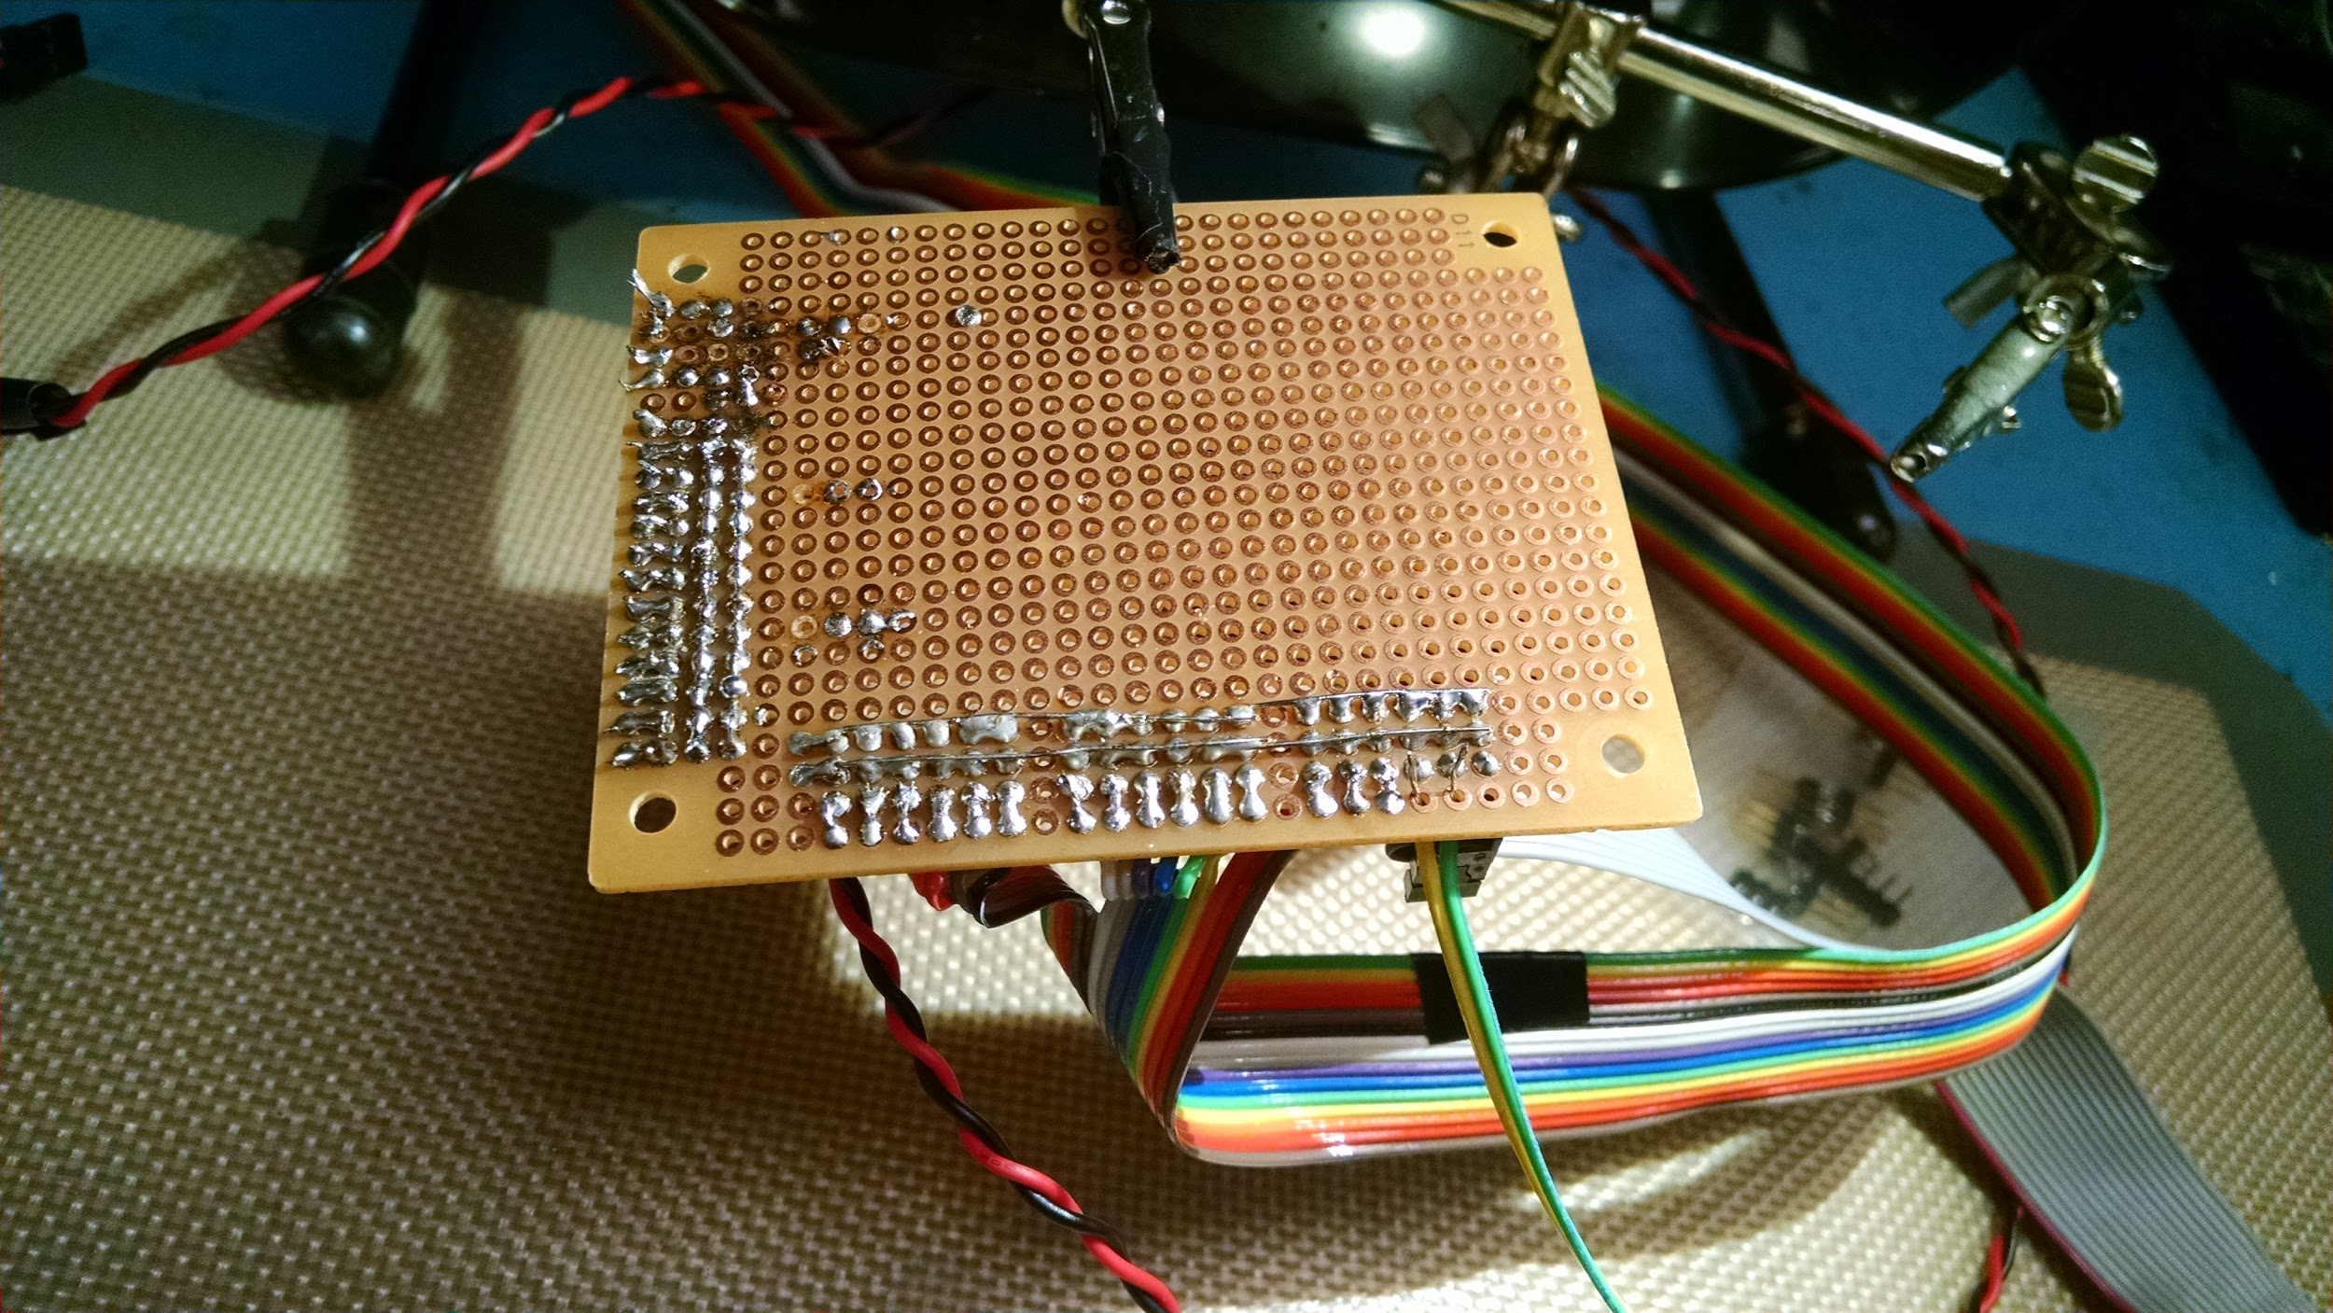
Servos: Robot Hardware
Robot body has 15 Servos:
4 for each arm (Forearm, Elbow, Shoulder Up/Down, Shoulder Twist)
3 for each leg (Knee, Hip Up/Down, Hip Twist)
1 for neck
Robot had additional servos for facial expressions that were removed for the construction of the new head
Servos are controlled by a Pololu Mini Maestro servo controller, which receives instructions via serial connection from the Arduino Uno
Arduino contains functions that implement gestures and behaviors (waving, turning the neck, etc)

Slide 17
Servos: Robot Hardware
Robot body has 15 Servos:
4 for each arm (Forearm, Elbow, Shoulder Up/Down, Shoulder Twist)
3 for each leg (Knee, Hip Up/Down, Hip Twist)
1 for neck
Servos are controlled by a Pololu Mini Maestro servo controller, which receives instructions via serial connection from the Arduino Uno

Slide 18
Servos: Challenges
Servo hardware/connections/system is buggy. Hard to accurately and precisely set robot position.
Servos have a tendency to “jitter” a bit when placed.
All servo values must be precise, but have no relation to each other (no left/right symmetry)
Could not move serial control to Raspberry Pi, because we needed parallel execution of motions, as well as more serial connections

Slide 19
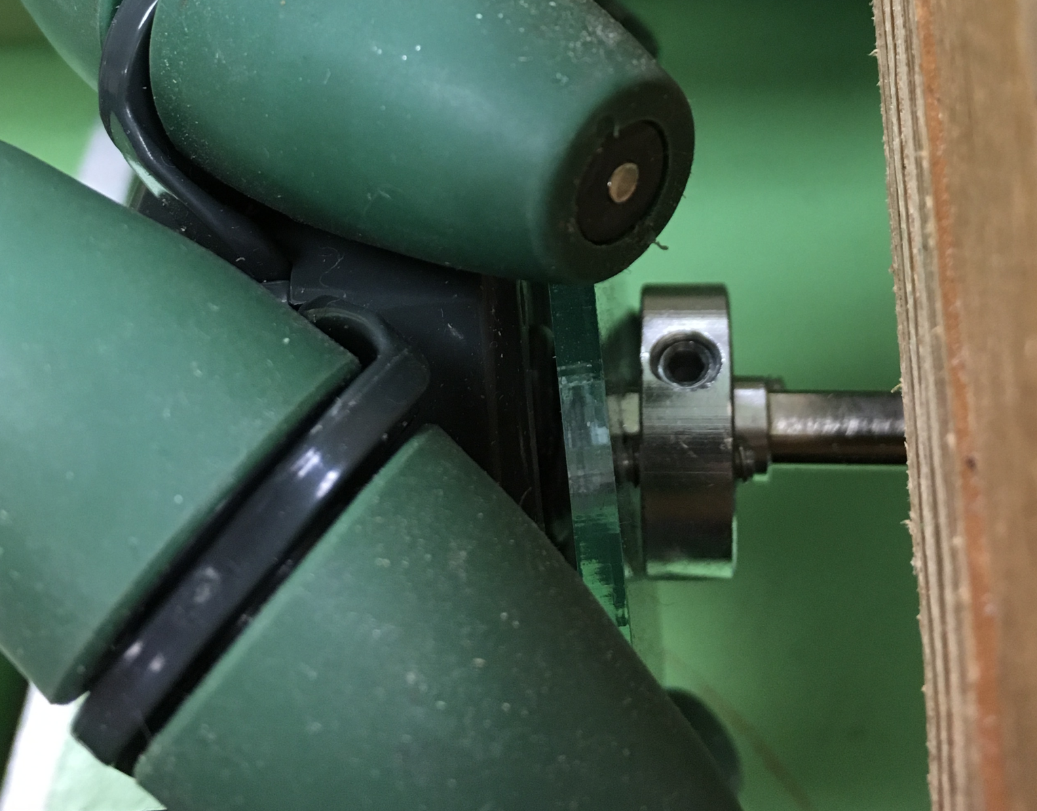
Omni-Wheels:
Pololu Qik 2s9v1 Controller :
Wheels controlled by two Pololu Qik 2s9v1- dual serial motor control.
Two Qiks are daisy chained to the Arduino for serial communication.
Variable speeds with PWM - 31.5kHz, 15.7kHz, 7.8kHz, 3.8kHz
Settings: 115200 baud, 31.5kHz, device ID - 9.
Challenges: One of the Wheels was wobbling, had to remove and fix it again.
Controlling the angles for turns.

Slide 20
Omni-Wheels: Future work
Controlling the angle of left/ right turns.
Develop smoother movement control and integrate vision and motion control.
Control Lateral left and right movements of the base.

Slide 21
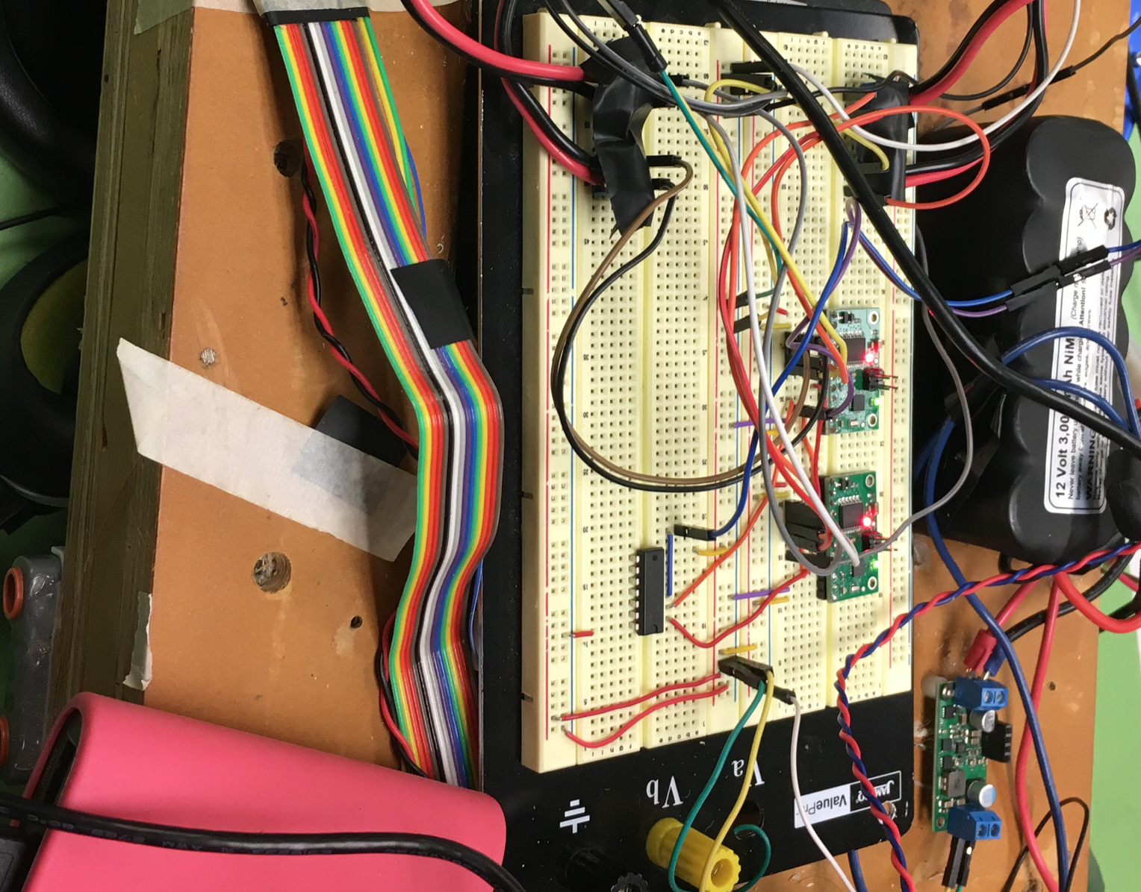
ROS with HW
Want to execute wheels and servos in parallel, but both require plenty of serial connections.
Wanted to use ROS nodes to start Arduino code for movements.
Created 3 nodes
Servo Controller node -Actions: Wave, Raise Arms, “no”, Neutral...
Motor Controller node -Actions: Forward, Backward, Spin Left, Stop...
Demo node (which sends commands to other nodes)
ROS nodes worked with other nodes, but failed to send data across pins to Arduino. We had to move all motion functions to Arduino

Slide 22
Demo

